Slide 1
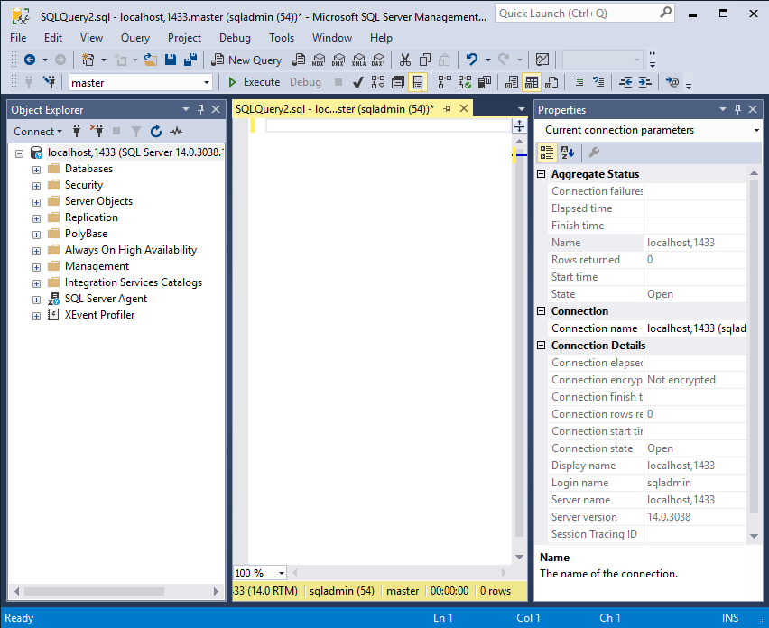
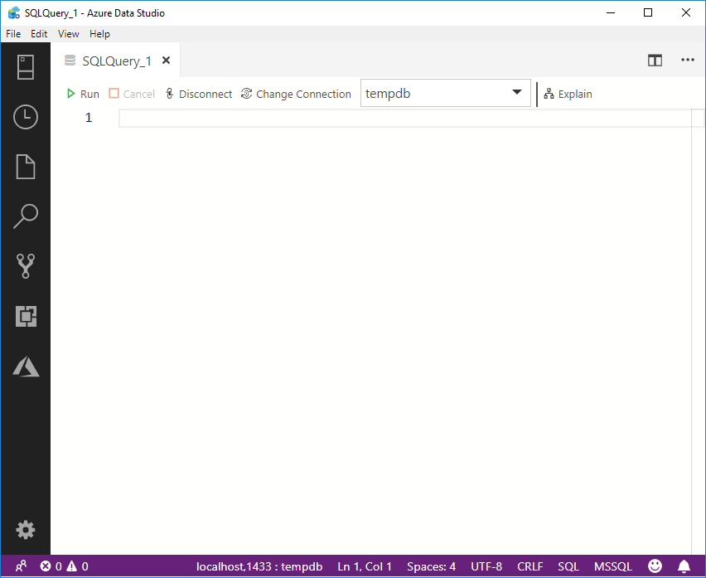
IDE for Transact-SQL Development
SQL Server Management Studio
Azure Data Studio

Slide 2
IDE for Transact-SQL Development
SQL Server Management Studio
Azure Data Studio
Based on Visual Studio
Traditional SQL Server Experience
Released independently of SQL Server
A lot of functionality
Based on VS Code
New, cross platform and open source
Very active development
A lot of free extensions

Slide 3
IDE for Transact-SQL Development
SQL Server Management Studio
Azure Data Studio
Is good for you if you do a lot of:
Complex configuration and administration
Security configuration and management
Database diagrams and table designers
Use sqlcmd mode or live query stats
Pointing and clicking rather than typing
Should be your choice if you:
Spend most of your time developing queries
Work with multi-file projects
Need source control
Need to quickly chart or visualise results
Prefer the keyboard experience
Full feature comparison: https://docs.microsoft.com/en-us/sql/azure-data-studio/faq?view=sql-server-2017

